Slide 1

Predicting the Mode of Childbirth using Machine Learning
by
N. Sasi Priya
Roll No. 194G1A0597
V. Namratha
Roll No. 194G1A0565
S. Sonika
Roll No. 194G1A05A4
J. Venu
Roll No. 194G1A05C3
Under the guidance of
Mrs. M. Soumya _{M.Tech(Ph.D)}
Assistant Professor
Department of Computer Science and Engineering
Srinivasa Ramanujan Institute of Technology
Autonomous
Rotarypuram Village, B K Samudram Mandal, Ananthapuramu – 515701.
2022-2023

Slide 2
Abstract
Nowadays, the method of delivery is a crucial factor in ensuring the well-being of both mother and baby. Currently, the decision on the mode of delivery is usually made by the attending physician, but if the wrong method is chosen, it can lead to various short-term and long-term health problems for both the mother and baby. The number of cases where doctors unnecessarily suggest a cesarean delivery is on the rise, and human error can also play a role in choosing the incorrect mode of delivery. To mitigate these risks, We Proposed a machine learning-based decision-making model to predict the most appropriate mode of childbirth. To attain our objective five different machine learning algorithms XGBoost, KNN, Random Forest, SVM, and Logistic regression models has developed based on the 22 features which include age, amniotic fluid, height, and weight. Among all the algorithms XGBoost got the highest accuracy.
Keywords-Machine Learning, mode of Delivery, XGBoost, KNN, Random Forest, SVM, Logistic Regression, Amniotic fluid.

Slide 3

Contents
Abstract
Introduction
Literature Survey
Existing System
Proposed System
Planning
Design
Implementation
Conclusion
Research Paper
References

Slide 4
Introduction
Health care is one of the integral sectors where a large amount of data is generated daily, and making effective decisions based on these data is therefore a challenge. Machine Learning is one the effective solution for making the decision.
Machine Learning provides the various algorithms to make effective decisions such as Decision trees, random forest, naïve bayes, K-nearest Algorithms and others.
These algorithms uses various evaluation parameters like Accuracy, Precision and recall,F1 score, Sensitivity and specificity, ROC curve and AUC.
Through the Machine Learning we are constructing a model which predicts the mode of childbirth.

Slide 5
Literature survey
Alisha Kamat[1] and other researched on the data generated during the nine months of pregnency. Inorder to best prediction of anomalies and threats, they are using the various techinques like cleaning, sorting and classification.
In this paper they mainly considered several parameters in that they shortlisted few parameters like age, body mass index, parity, glucose-fasting etc….Using these parameters they built two algorithms using decision tree and naive bayes.
The above parameters are used to predict the curbing cases because the increasing the cases during delivery to define the best section to take.
After selecting the parameters the numeric ranges was converted into categorical values.
The data was split into training and testing data using the ratio 0.67.
In this existing system it consider only predefined parameters and ignore all other parameters which may be used for prediction and also if one single value is missed then the system will not proceed because they are only two algorithms are used in this paper.
z

Slide 6
Literature survey
Kowsher [2] and others proposed a computerized method of decision making for selecting the appropriate mode of childbirth. Since the process is computerized then the machine learning algorithms are the best because of less error rate.
They have used many different classifiers to make the decision more accurate and real.
The considered dataset has 3 categorical variables including presentation, reason,membrane.
Since the values are categorical they have encoded into numbers by using one-hot encoding.
Finally they perform analysis on different algorithms using 11 statistical measurements like accuracy,FI score,PS,RS, FBS,HL, and other.
They compared the performance of all the proposed models among them, Decision tree is the one of the algorithms with most accuracy.

Slide 7
Literature survey
Nafiz Imtiaz Khan [3] researched to predict whether or not the cesarean section is necessary with the help of data mining and consequently, increasing the safety of the mother and newborn during and after childbirth by avoiding unnecessary cesarean section.
The dataset that they used has a class imbalance problem so they used SMOTE Technique to eliminate all the imbalance issues.
To attain the objective three different ensemble prediction models are used AdaBoost and Catboost
Among all these CatBoost and AdaBoost with accuracy 80.6%.
They have considered the main features are amniotic liquid, medical indication, fetal intrapartum ph, number of previous cesareans, pre-induction used to predict the target outcome accurately.

Slide 8
Literature survey
Zahid ullah, and Farukh Saleem [4] researched on normal and Cesarean delivery. They first examine the existing data and also previous medical records about the mode of delivery were investigated using machine learning algorithms.
They extracted some meaningful insights from unseen cases. So Various prediction Models like decision tree, AdaBoostM1, bagging and are used to train the model.
In this first, the existing data was enriched because this would increase the result of accuracy in order to predict the mode of childbirth.
Since the dataset contains fewer records they have SMOTE Technique which oversamples the data.

Slide 9
Literature survey
Muhammad Nazrul Islam [5], Tahasin Mahmud and others explore the best possible features for predicting the mode and by using these features they have proposed five different algorithms.
They had conducted the interviews and structured reviews inorder to identify the best possible features. Finally they revealed that 32 features are the best for suitable prediction mode of child birth.
These features are grouped and proposed algorithms are applied for analysis and prediction.Based on the Evaluation parameters they finally concluded that stacking classifier(FI score is 97.4%) is the best.

Slide 10
Existing System
The Existing System mainly considers two types of delivery, whether normal or cesarean.
The Dataset contains 10 parameters like age, Glucose Level, Parity, Cervical Length etc.
They have used various algorithms like naive Bayes, and Decision Tree. They have compared these algorithms’ performance.
Finally, They concluded that Naive Bayes gave the best accuracy.
The Main Drawback of this System is it predicts only normal delivery.
It is an application that contains 10 predefined parameters only. Apart the system does not contain the most important features.
They have used QT Creator to develop a interface that take 10 parameters and predict the output

Slide 11
Proposed System
A maternal healthcare application to assist doctors in predicting a mode of delivery that is compatible with the characteristics of the mother would be helpful in reducing childbirth complications.
In this, we have used various Machine Learning algorithms like K-nearest neighbors, Random Forest, SVM, Logistic regression and XGBoost.
Based on the accuracy of these algorithms we are going to predict which mode of delivery is suitable at that time.
The Dataset contains 22 attributes with five class label.
In this, we developed a website for the prediction of the type of delivery that is possible.
Since the dataset contains categorical values we use the label encoder to convert them into numerical values.

Slide 12
Planning
Objective:
The objective of our project is to employ different machine learning algorithms to predict the mode of childbirth and to compare and analyze them.
Scope:
The Scope of this project is that predicts which type of delivery it is(Normal, cesarean, Emergency).
Performance:
The Performance of our project depends on how correctly model Classifies it as a normal , cesarean, Emergency, or Vacuum Extraction.

Slide 13
Planning
Time Estimation: Basically,Our Project is divided into two phases.
Phase – 1: Pre-requisites,Planning, and designing.
Table1:Activities Performed in Phase -1
S.No | Activity | Duration
1 | Domain Selection | 1 week
2 | Literature Review and Problem Definition | 2 Weeks
3 | Planning and Design | 3 Weeks

Slide 14
Phase -2:Developing, Implementation,Testing
Table2: Activities to be Performed in Phase-2
S.No | Activity | Duration
1. | Code Development | 3 Week
2. | Implementation | 2 weeks
3. | Testing | 2 Weeks

Slide 15
Planning
Software Model: Agile Model
To implement our project, we used Agile Methodology. It is a software development approach based on iterative development. Agile methods break tasks into smaller iterations. Plans regarding the number of iterations, the duration, and the scope of each iteration are clearly defined in advance. The division of the entire project into smaller parts helps to minimize the project risk and to reduce the overall project delivery time requirements.
In Agile There are a lot of frameworks like Scrum, Kanban, etc. Out of these, we have used the scrum method. Scrum is a framework of rules, roles, events, and artifacts used to implement Agile projects. It is an iterative approach, consisting of sprints that typically only last one to four weeks, with the objective of continuously improving a product.

Slide 16
Planning
System Requirements:
Hardware Requirements: Processor: I3/Intel Processor
Hard Disk: 160GB
RAM : 8Gb
Software Requirements: Operating System: Windows 7/8/10
Server Side Script: Python 3.11
IDE : GoogleCollab, VisualStudios
Libraries : Sklearn, Pandas, Numpy, matplotlib, OpenCV
Frontend : HTML, CSS, Javascript

Slide 17
Planning
Functional Requirements:
User will give the input to the System.
The System Will take the dataset
Non-Functional Requirements:
Portability
User-friendly model
Maintability

Slide 18
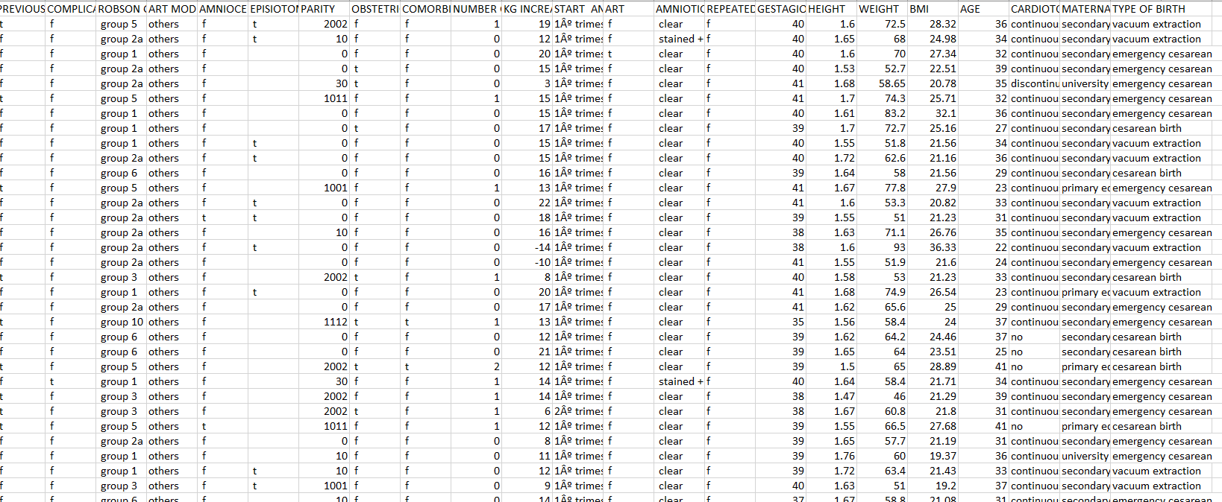
Planning
Dataset:

Slide 19
Design
System Architecture:
User
Dataset
Preprocessing
Data splitting
Parameter Values
Mode of Delivery
Training model
Classifier
Predictor

Slide 20
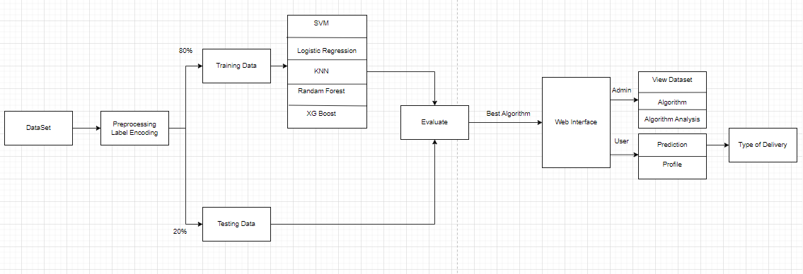
Design
Work Flow

Slide 21
Implementation
Libraries: These are frameworks in python to handle commonly required tasks. We implore any budding data scientists to familiarize themselves with these libraries:
NumPy :
NumPy, which stands for Numerical Python, is a library consisting of multidimensional array objects and a collection of routines for processing those arrays. Using NumPy, mathematical and logical operations on arrays can be performed.
Scikit Learn:
The sklearn library contains a lot of efficient tools for machine learning and statistical modeling including classification, regression, clustering and dimensionality reduction.
Pandas:
Pandas is an open source Python package that is most widely used for data science/data analysis and machine learning tasks. It is built on top of another package named Numpy, which provides support for multi-dimensional arrays.

Slide 22
Implementation
Importing the required modules:
import pandas as pd
import numpy as np
from sklearn.model_selection import train_test_split
from sklearn.ensemble import RandomForestClassifier
from sklearn.neighbors import KNeighborsClassifier
import xgboost as xgb
from sklearn.linear_model import LogisticRegression
from sklearn.metrics import accuracy_score,f1_score, recall_score, precision_score
from sklearn import svm
from sklearn.metrics import accuracy_score
import matplotlib.pyplot as plt

Slide 23
Implementation
#Preprocess the data
from sklearn.preprocessing import LabelEncoder
df=pd.read_csv('/content/drive/MyDrive/Colab Notebooks/child_birth_classification/new_folder/childbirth2.csv')
df.info()
df=df.drop(['TYPE OF BIRTH '],axis=1)
L=LabelEncoder()
Y = L.fit_transform(df_final_col3['TYPE OF BIRTH '])
X = encoder.transform(df2)
Y= decoder.transform(df['TYPE OF BIRTH '])
x_train,x_test,y_train,y_test=train_test_split(X,Y,test_size=0.2,random_state=0)

Slide 24
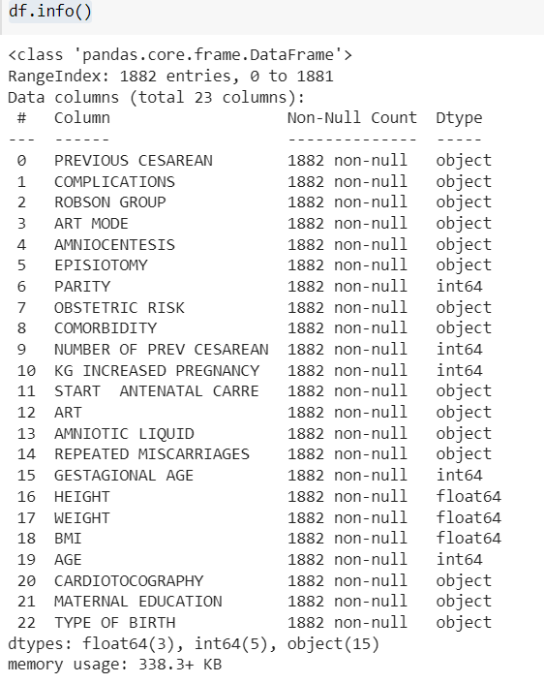
Implementation

Slide 25
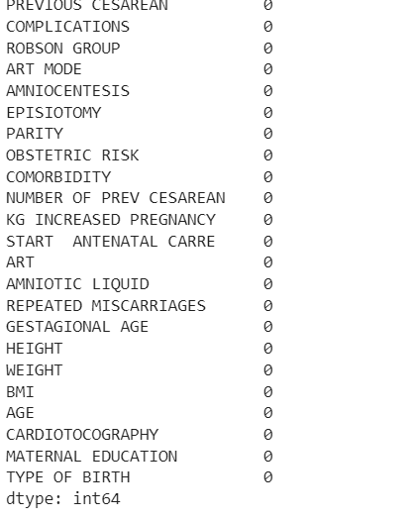
Implementation
Checking the null values
df.isna().sum()

Slide 26
Implementation
#Training the Logistic Regression, Random Forest, SVM, XGBoost, and KNN models on the training data:
models = [LogisticRegression(),XGBClassifier(), KNeighborsClassifier(),RandomForestClassi
fier(),SVC()]
for model in models:
name = type(model).__name__
Name.append(name)
model = OneVsRestClassifier(model)
begin = time.time()
model.fit(x_train,y_train)
prediction = model.predict(x_test)
Accuracy.append(accuracy_score(prediction,y_test))
Precision.append(precision_score(prediction,y_test,average = 'macro'))

Slide 27
Implementation
Recall.append(recall_score(prediction,y_test,average = 'macro'))
F1_Score.append(f1_score(prediction,y_test,average = 'macro'))
print(name + ' Successfully Trained')
Dict = {'Name':Name,'Accuracy':Accuracy,'Precision_score':Precision,'Recall_score':Recall,
'F1_score':F1_Score}
model_df = pd.DataFrame(Dict)

Slide 28
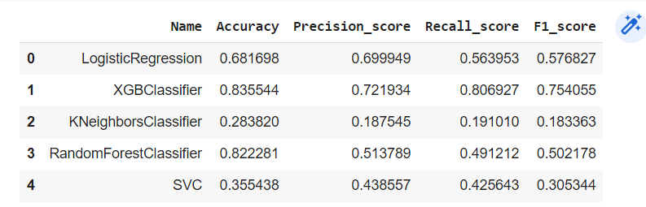
Implementation
Accuracy Of the Models

Slide 29
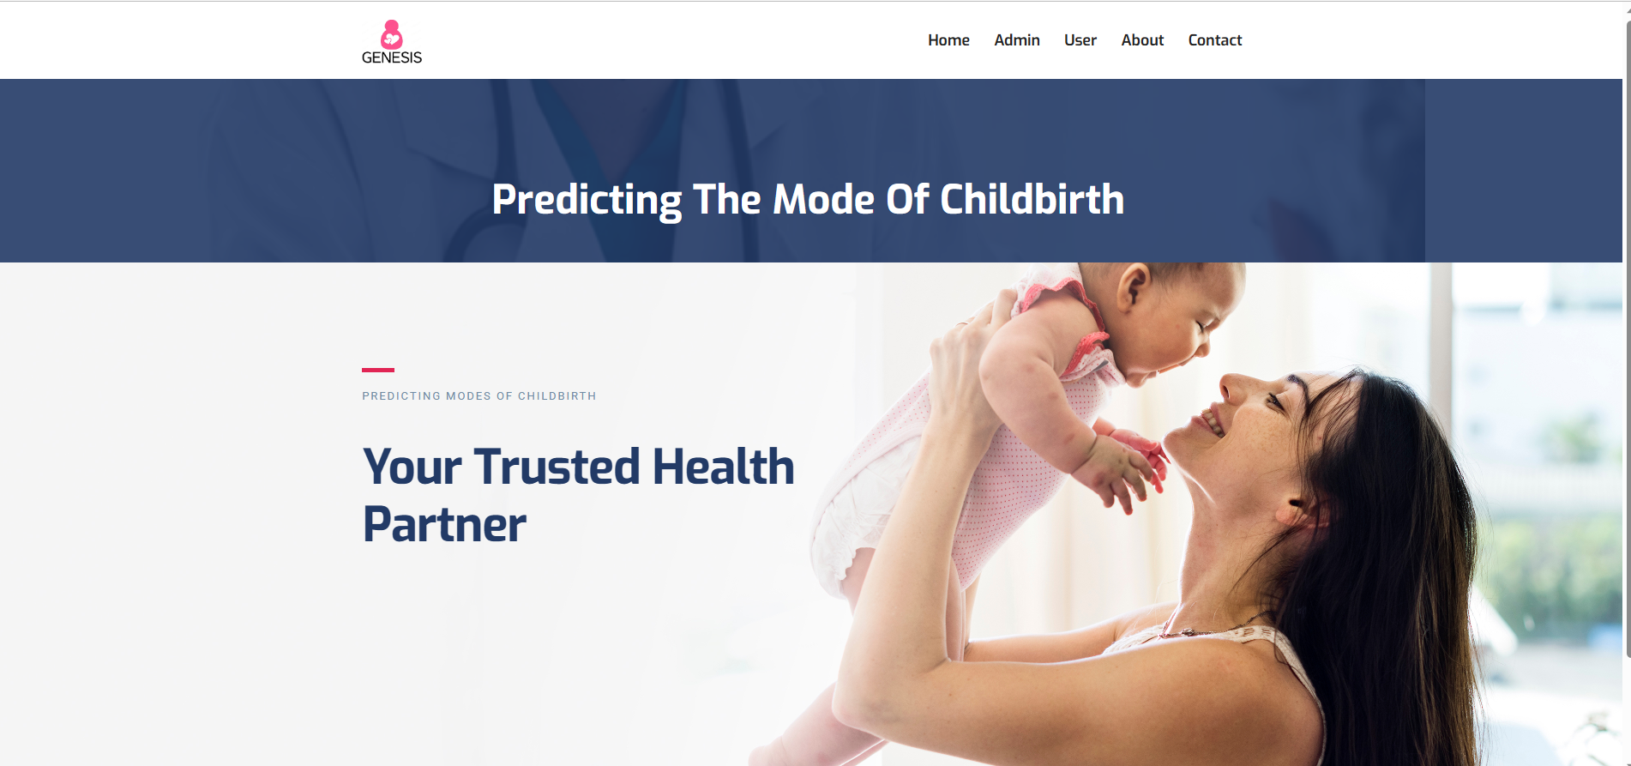
Implementation
Home Page:

Slide 30

Implementation
User Login Page:

Slide 31
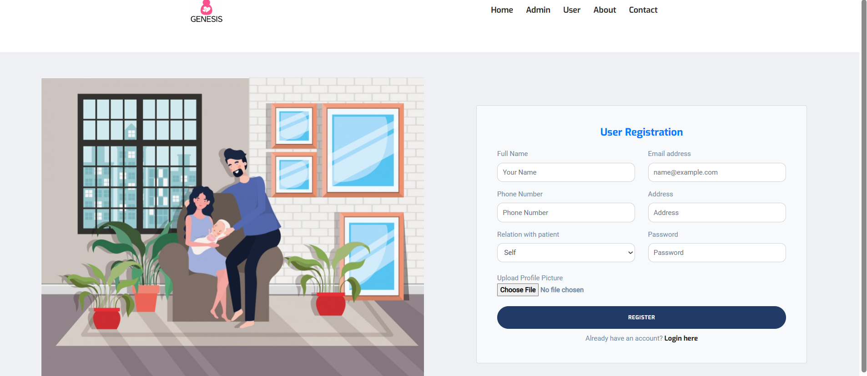
Implementation
Registration Page:

Slide 32
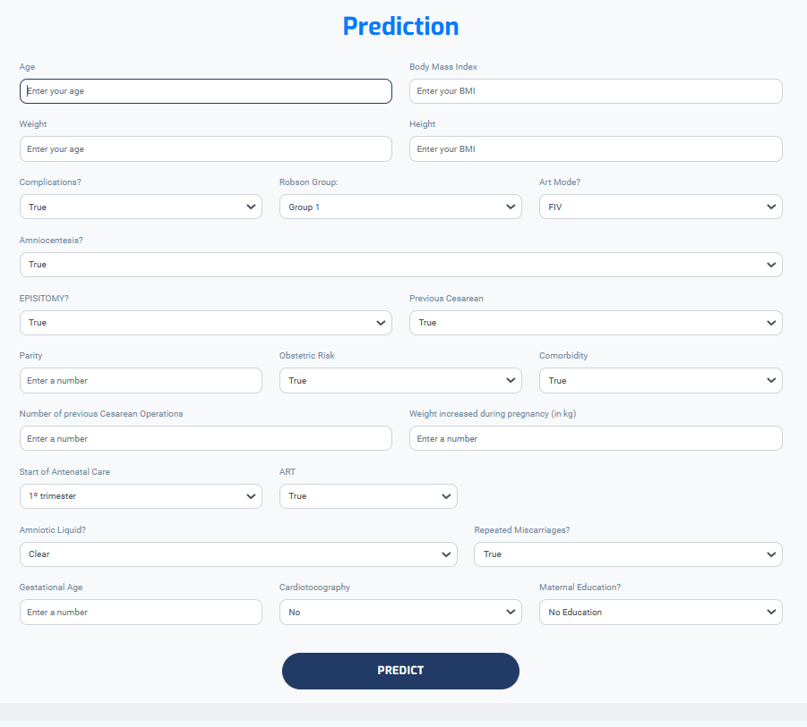
Implementation
User Input:

Slide 33

Implementation
Output:

Slide 34
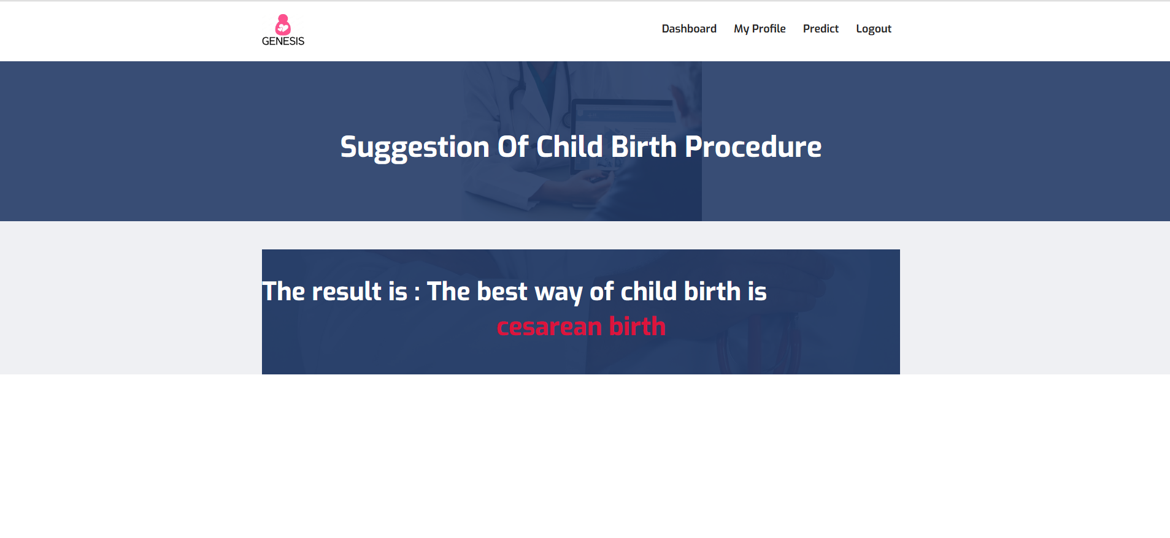
Implementation

Slide 35
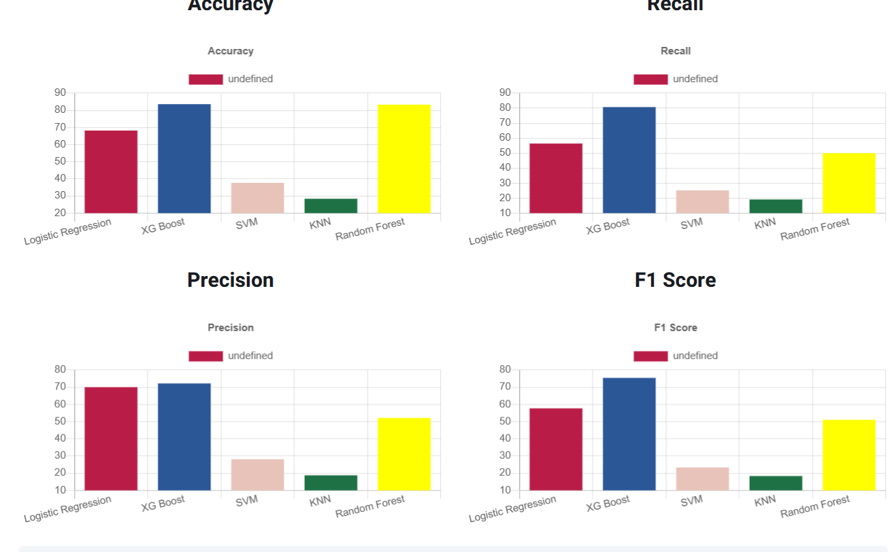
Implementation
Algorithms Comparison

Slide 36
Conclusion
It has been observed that predicting the mode of childbirth is very difficult. Up to now, only traditional methods are used to predict the mode of childbirth. Choosing the most suitable modes of childbirth is vital for the safety of both mothers and infants. This study therefore all the possible features are taken into consideration and various machine Learning Techniques have been applied. Later, the results of applying five machine-learning algorithms were used to determine the most appropriate algorithm for predicting the best childbirth model. In future work, use the better models and Instead of attributes use the images as attributes to get faster results.

Slide 37
Research Paper
Research Paper Final

Slide 38
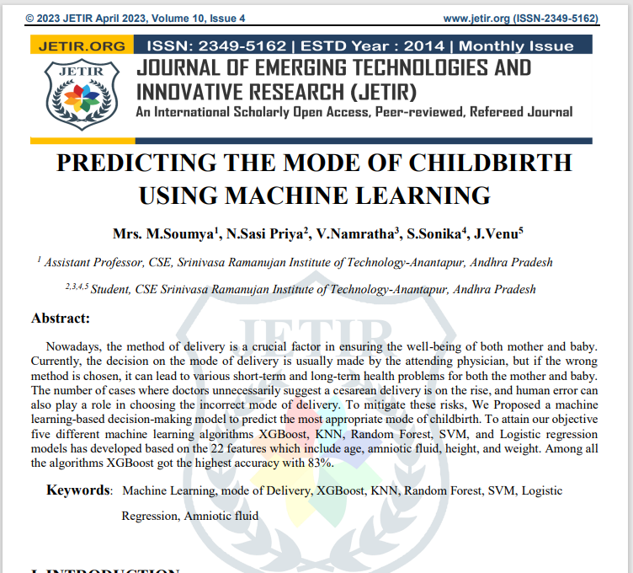
Published Paper

Slide 39
References
[1]. Alisha Kamat, Veenal Oswal, Manalee Datar, “Implementation of Classification Algorithms to Predict Mode of Delivery “ International Journal of Computer Science and Information Technologies, Vol. 6 (5) , 4531-4534.
[2]. Kowsher, Anik Tahabilder, Nusrat Jahan Prottasha, Kaiser Habib, “Predicting the Appropriate Mode of Childbirth using Machine Learning Algorithm “ International Journal of Advanced Computer Science and Applications, Vol. 12, No. 5, 2021.
[3]. Nafiz Imtiaz Khan ,Tahasin Mahmud, ‘’Prediction of Cesarean Childbirth using Ensemble Machine Learning Methods’’ 22nd International Conference on Information Integration and Web-based Applications & Services
[4]. Zahid Ullah, Farrukh Saleem ,Mona Jamjoom, Bahjat Fakieh, “Reliable Prediction Models Based on Enriched Data for Identifying the Mode of Childbirth by Using Machine Learning Methods” Published on 4.6.2021 in Vol 23, No 6 (2021): June
[5]. Muhammad Nazrul Islam, Tahasin Mahmud, “Exploring Machine Learning Algorithms to Find the Best Features for Predicting Modes of Childbirth” Published in: IEEE Access ( Volume: 9)

Slide 40
Thank You!!!

